Slide 1
Litter Detection using Deep Learning
By Team Litter Locators

Slide 2
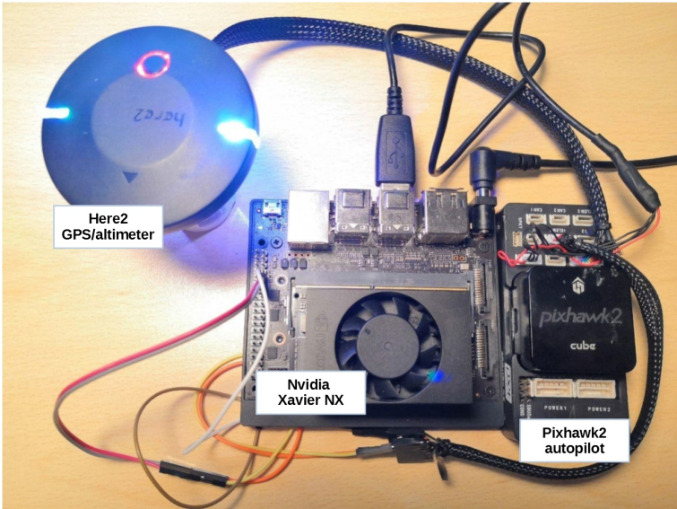
Paper Summary
Detect trash from UAV (Unmanned Aerial Vehicle)
Runs on space and power constrained hardware
NVIDIA Xavier NX
Ran several different models with differing data types
YOLOv4, VOLOv4-tiny, YOLOv3, YOLOv3-tiny, RNN, etc
INT8, FP16, FP32, FP64
More detailed data types had higher accuracy and less inferences/sec
We needed to re-test these models on Google Colab
Our hardware is not space or power constrained
Notes:
There were more models than the ones listed: with YOLO versions going up to YOLOv8, including YOLOv8-tiny, Fast RNN, CNN, etc
Measure model performance primarily through MAP (Mean Average Precision) fixed at IoU (Intersection over union) of 50%.
Mean Average Precision = AP (Average Precision, the weighted mean of precisions achieved at each threshold of the Precision-Recall curve)
Take average of the AP Averages for different bounding boxes as long as IoU is 50%.
Each one of these model types was trained on different data types (integer vs floating point: with differing floating point depth)
For example, YOLOv4 has a Mean Average Precision of 78.5% with FP32, 78.4% with FP16 and only 16.6% with Integer 8. This shows as the models get more lightweight and faster to perform inference with, they become less accurate.
Re-trained to get fair assessment of other model setups when not restricted on power.

Slide 3
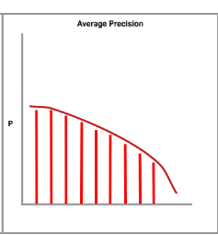
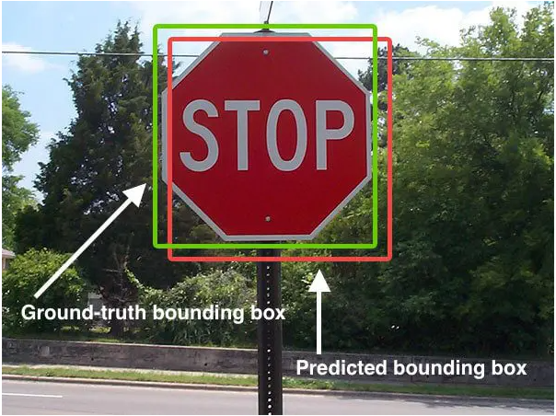
mAP (mean Average Precision) & IoU (Intersection over Union)
Notes:
Measure model performance primarily through MAP (Mean Average Precision) fixed at IoU (Intersection over union) of 50%.
Mean Average Precision = AP (Average Precision, the weighted mean of precisions achieved at each threshold of the Precision-Recall curve)
Take average of the AP Averages for different bounding boxes as long as IoU is 50%.
increase in recall from the previous threshold used as the weight.

Slide 4
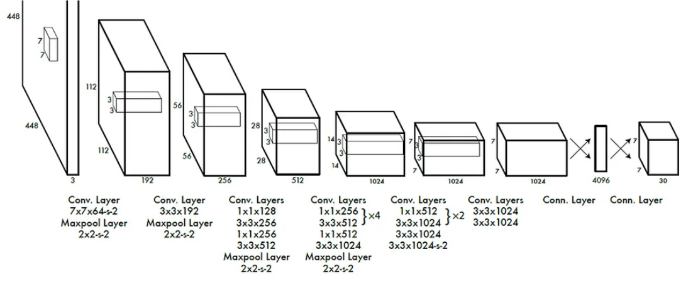
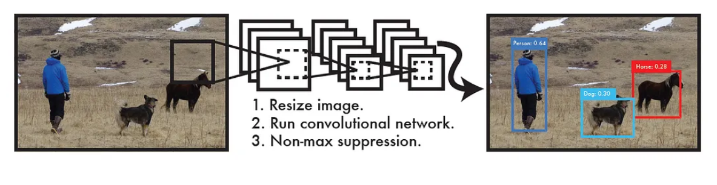
YOLO (You Only Look Once)
Yolo utilizes a single neutral network .
End to end training with a joint loss function integrates detection and recognition components.
YOLO skips region proposals, refining anchored bounding boxes via regression.
Simultaneously predicts class labels during bounding box refinement.
Original YOLO achieves over a hundred frames per second for fast imaging processing.

Slide 5
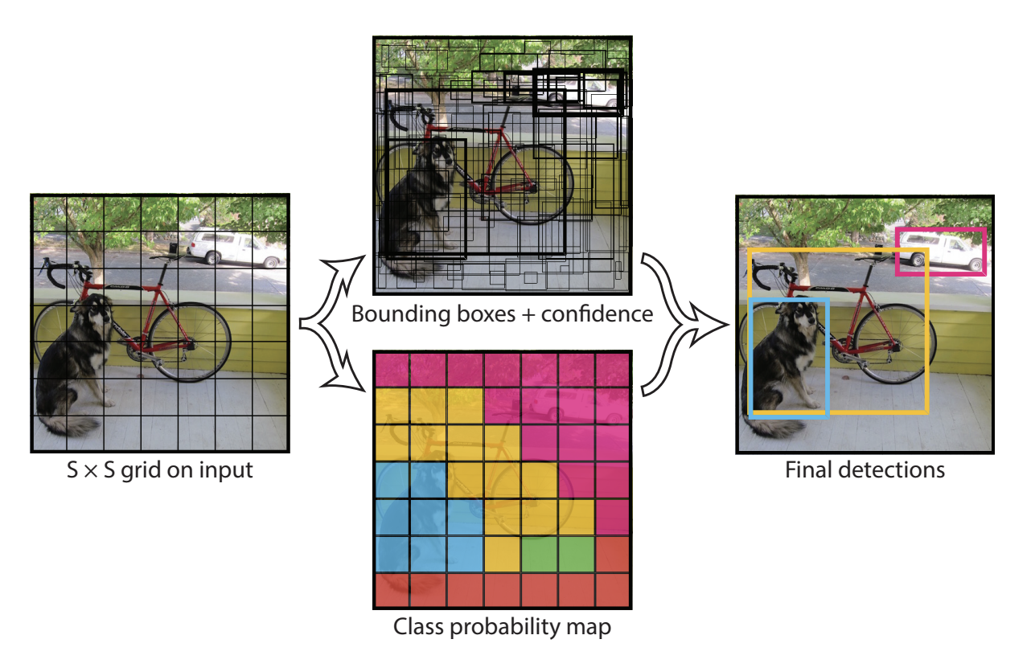
YOLO Continued
Notes:
The model predicts 2 different types of values at once. 1) It predicts center and size of the bounding box based on each segment. 2) It predicts the class to which each of the segments belong to.
The algorithm then pairs both the predictions, appropriate bounding box with the appropriate classification, such that IoU of that bounding box is the highest.

Slide 6
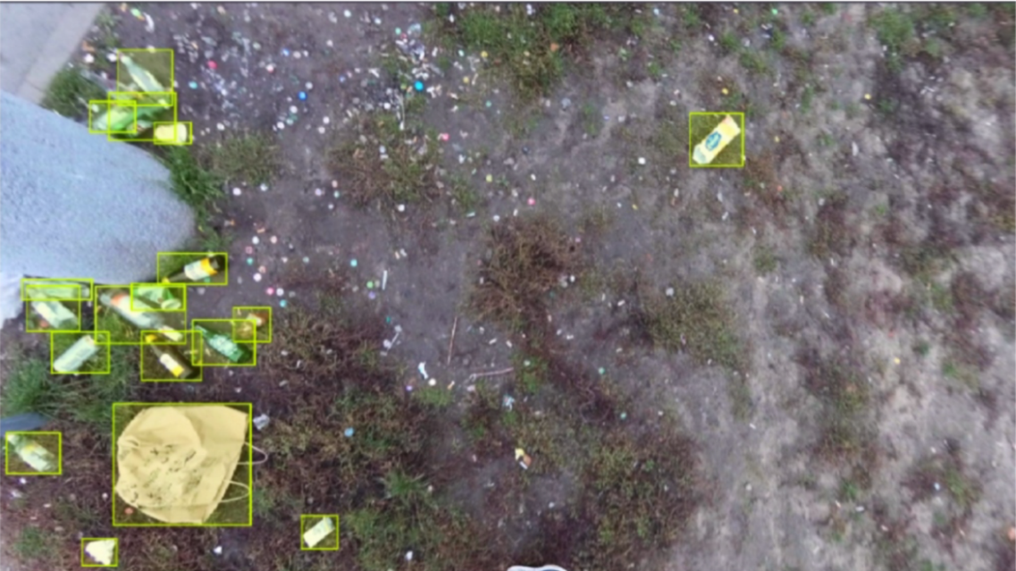
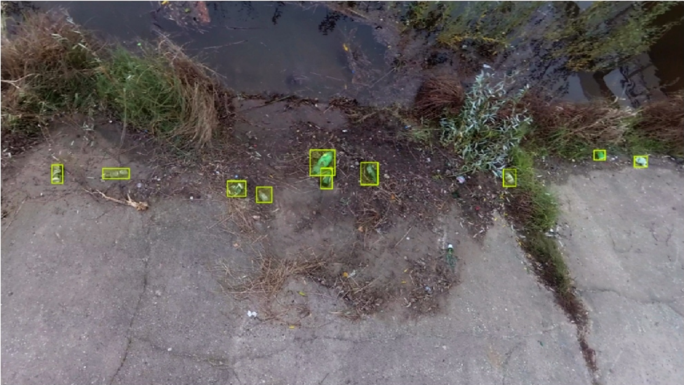
Dataset
Dataset contains 772 images and 3718 annotations
Pre-annotated with bounding boxes and segmentation masks
Percentage of image area occupied by object less than other similar datasets
Images filmed from directly above ground (no angled images)
Notes:
We could prevent training bias better if we had more images in different environments and scenarios but this is plenty for our project due to the large amount of annotations on the data.
There could also be issues with the images only being from directly above the ground, as the model might be unable to detect trash when the camera or the ground is at an angle.
(UAVVaste dataset)

Slide 7
Our Re-trained Models
Trained on Google Colab GPU session with student credits
Tensorflow based Models w/ custom library
Allows us to better interact with the model
Re-Trained: YOLOv4, YOLOv4-Tiny, YOLOv5, YOLOv6, YOLOv7
Notes:
We re-train the models the author trained on this paper, and we used the google colab GPU session to train.
The models we trained are yolov4, yolov4-tiny,YOLOv5, YOLOv6, YOLOv7
We will discuss results about training these models at the end of our presentation, in the empirical results section. We will next go over our model that we designed.

Slide 8
Our Custom Model Design
YOLO predicts both class probability and bounding boxes, making the model heavy.
We can create a model that is lightweight (allowing for more inferences per second)
We do this by dropping the ability for the YOLO model to predicting the bounding boxes
Goal is to maintain precision while greatly increasing number of inferences per second
Our model would be used when a drone selects a particular trash item for pickup
Notes:
The original paper discusses how the models mentioned could be used with drones to not just identify, but also pick up trash.
Our lightweight model could be run when a more precise model detects a particular trash item for pickup. This model could be run quickly, allowing a drone to make micro adjustments to its movement to accurately pick up trash.
Our model architecture is described on the next slide.

Slide 9
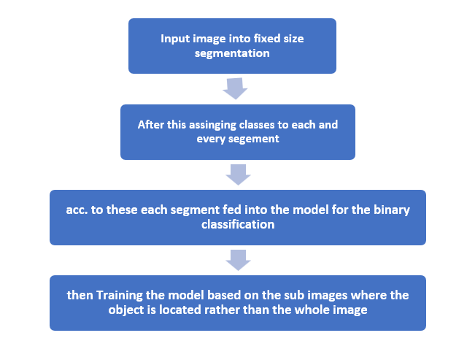
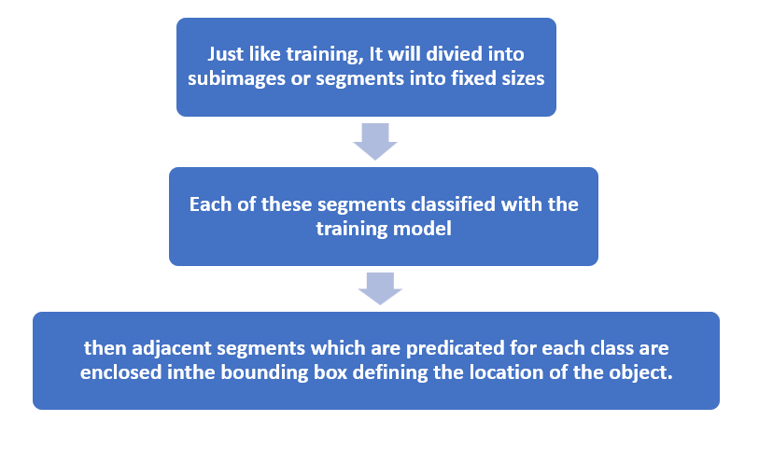
Our Custom Model Architecture
Training Model
Result
Notes:
Here’s the flowchart for the training model and result with the steps.

Slide 10
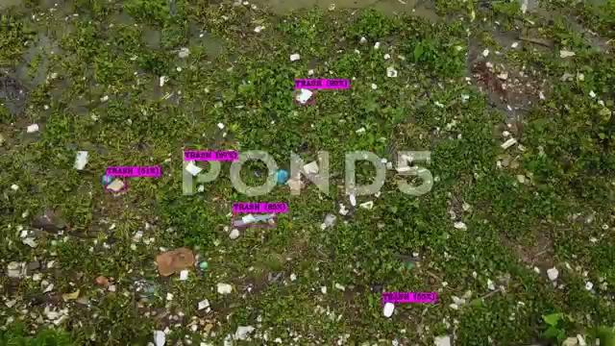
Example Output
Notes:
Watch how it identifies and classifies litter making on-site cleanup a breeze.

Slide 11
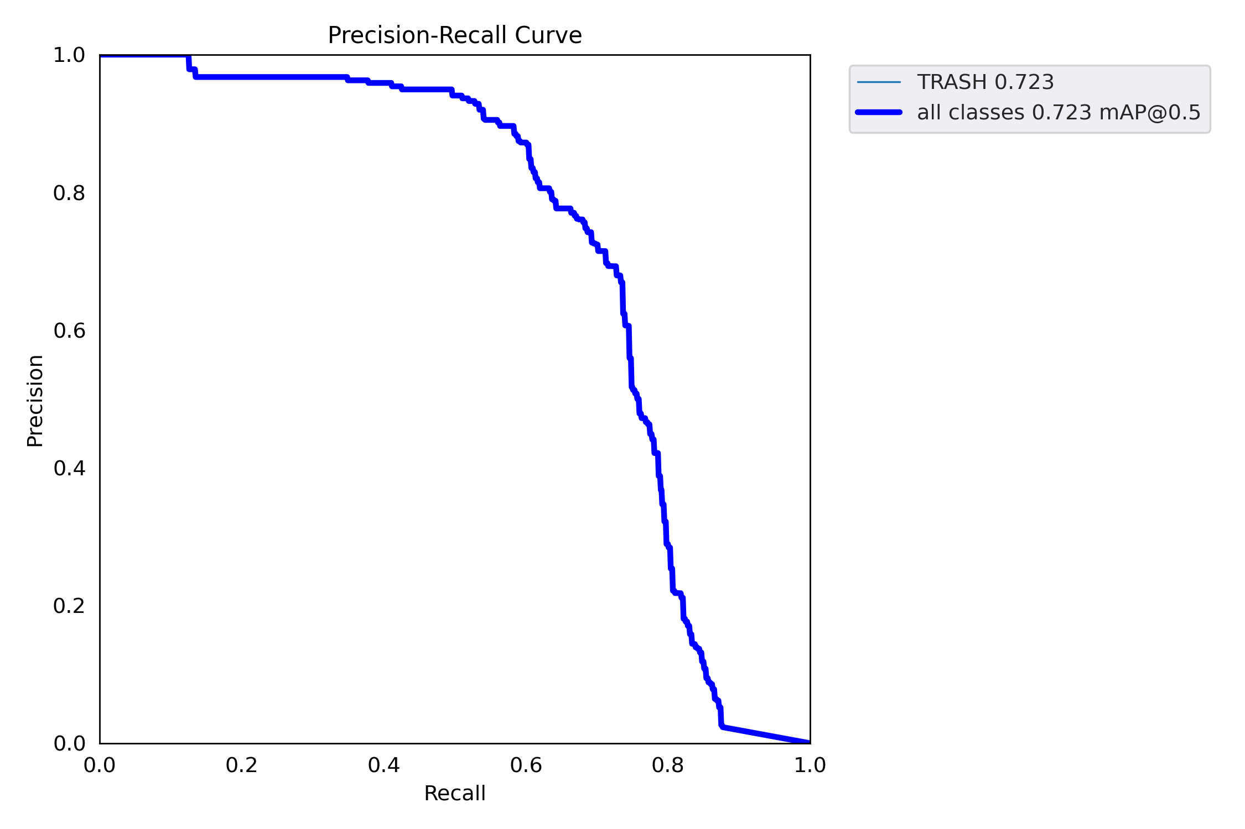
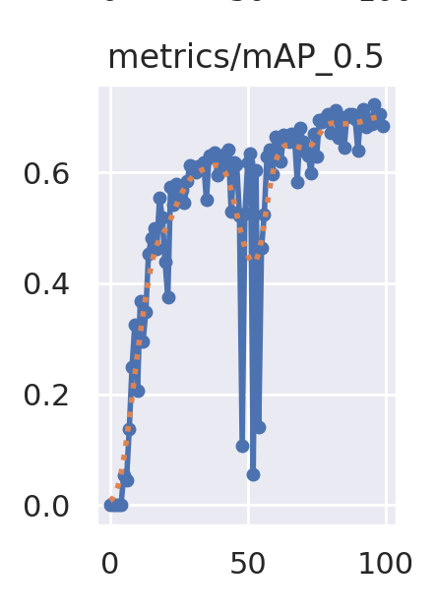
YOLOv5 Results -

Slide 12
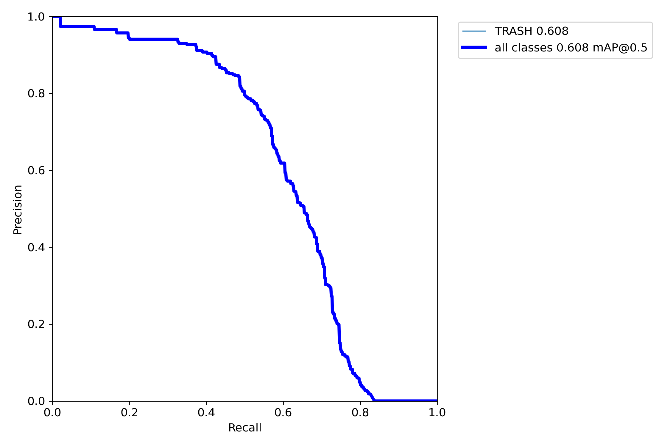
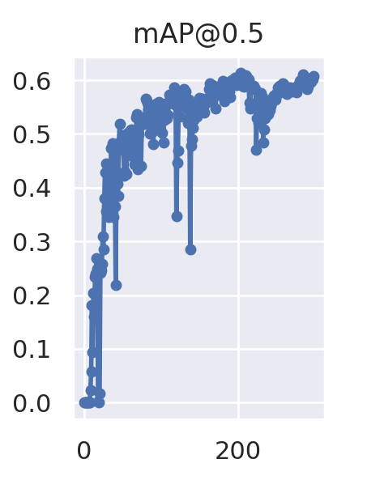
YOLOv7 Results -

Slide 13
mAP @ IoU 0.5
YOLOv4 | YOLOv4-Tiny | YOLOv5 | YOLOv6 | YOLOv7
0.786 | 0.645 | 0.723 | 0.766 | 0.61

